Slide 1
Anchoring Tree Appraisal
A Multi-Method Approach
Terrence P. Flanagan
BCMA #PN-0120BMTL
James Komen
BCMA #WE-9909B
RCA #555
March 8, 2019

Slide 2
Introductions
Terrence P. Flanagan
Member of ASCA TPAQ Committee
Past president and board member of ISA
Chair of the panel of experts for TRAQ
Past President and board member of PNW-ISA
Board Certified Master Arborist (BCMA)
James Komen
Registered Consulting Arborist (RCA) and Board Certified Master Arborist (BCMA)
Author of articles and studies regarding appraisal published in ISA Arborist News, Western Chapter Newsletter, ASCA Newsetter.

Slide 3
James’ Papers
Studies on Appraisal
An Analysis of the Field Precision of the CTLA Trunk Formula Method, Arboriculture & Urban Forestry 2015. 41(5): 279–285
Inter-Appraiser Variability for Written Appraisals as published by Western Arborist 2017 Winter
Field Precision of Collaborative-Appraisal Using CTLA Trunk Formula Method as published by Western Arborist
The Importance of Tree Appraisal as published by TCIA Magazine June 2016 / Response Letters as published by TCIA Magazine August 2016
Critical Analysis of the ATA Formula as published by Western Arborist
Full article text at: www.jameskomen.com/articles-and-research.php

Slide 4
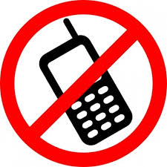
Housekeeping
Turn off Cell Phones
Restrooms
Please engage us and each other
Respect your Peers’ Opinions
Follow along in your workbook

Slide 5
Introduction

Slide 6
Introduction – Group A ONLY

Slide 7
Introduction – Group A ONLY
What is the probability that the population of Japan is greater than 50 million people?

Slide 8
Introduction – Group A ONLY
What is the probability that the population of Japan is greater than 50 million people?
What is the population of Japan?

Slide 9
Introduction – Group B ONLY

Slide 10
Introduction – Group B ONLY
What is the probability that the population of Japan is greater than 150 million people?

Slide 11
Introduction – Group B ONLY
What is the probability that the population of Japan is greater than 150 million people?
What is the population of Japan?

Slide 12
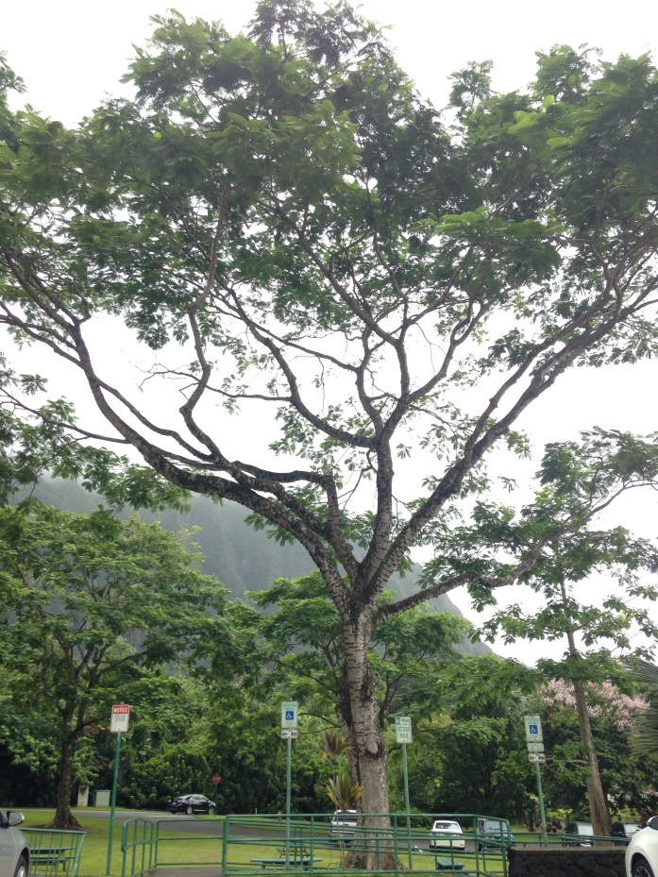
Introduction

Slide 13
Anchoring
People base their opinions off of anchors
Types of Anchors
Original Research
Opinions of Others
Personal Experience

Slide 14
Anchoring
What is the population of Japan today?

Slide 15
Anchoring
Population of Japan
Encyclopedia from 1985 says population is 120.2 million people

Slide 16
Anchoring
Population of Japan
Encyclopedia from 1985 says population is 120.2 million people
My Japanese-American friend says population is at least 130 million people

Slide 17
Anchoring
Population of Japan
Encyclopedia from 1985 says population is 120.2 million people
My Japanese-American friend says population is at least 130 million people
Wikipedia projects population to be 126 million people by January 2017.

Slide 18
Anchoring
Population of Japan
Encyclopedia from 1985 says population is 120.2 million people
My Japanese-American friend says population is at least 130 million people
Wikipedia projects population to be 126 million people by January 2017.
Google says population is 126.8 million people

Slide 19
Anchoring
Population of Japan
Encyclopedia from 1985 says population is 120.2 million people
My Japanese-American friend says population is at least 130 million people
Wikipedia projects population to be 126 million people by January 2017.
Google says population is 126.8 million people
Census says population is 127,110,000 in February 2016

Slide 20
So what’s the right answer?

Slide 21
So what’s the right answer?
Choose one and defend it

Slide 22
Tree Appraisal
Trees Have Value
Appraisal is an Opinion of Value

Slide 23
Ethics in Appraisal
Must remain objective
Appraisals with the same assignment should remain the same regardless of the client or side
Avoid boosting or suppressing value to support a side
“Bought yourself a bigger tree.”
“Massaging numbers”
Revisions of substance
“I would be happy to correct mistakes, but not to change facts and/or my opinion.”

Slide 24
The Guide for Plant Appraisal
Council of Tree and Landscape Appraisers
ISA Regional Plant Appraisal Committees (RPACs)
Regional Species Classification Guides

Slide 25
Tree Appraisal
Reasons for Appraisal
Disputes/Litigation
Inventory/Management
Insurance
Construction Bonding
Municipal Fines

Slide 26
Approaches to Appraisal
Sales Comparison Approach
Paired Sales
Hedonic Regression Technique
Timber Sales
Income Approach
Present value of income generated by trees
Indirect Income – benefits of trees
Cost Approach

Slide 27
Steps in an Appraisal
Define Appraisal Problem
Define the Scope of Work
Collect Data
Analyze the Data
Reconciliation
Conclude an Opinion

Slide 28
1) Define Appraisal Problem
Who is the CLIENT?
Who is the INTENDED USER?
What is the PURPOSE of the appraisal?
When is the EFFECTIVE DATE of the appraisal?
What ASSUMPTIONS must be made?
What LIMITING CONDITIONS must be managed?

Slide 29
2) Define the Scope of Work
First contact
Date and time
Reason for client to call?
Possible conflict of interest?
Phone/email
Background on Case
History of situation
Existing documentation
Pertinent information not observable on site
Previously involved consultants
Boundaries and survey

Slide 30
3) Data Collection
Site Inspection
Permission to Enter Property
Time and Date of site visit
Photograph Everything

Slide 31
3) Data Collection
Recording Tools
Camera
Tape measure/D-tape
Clinometer
Hypsometer
Biltmore stick
Sample Collection
Plastic bags
Mason Jars
Soil Auger
Diagnostic Tools
Probe
Mallet
Binoculars
Hand Lens
Shovel/Trowel
Soil moisture meter
Other Tools?

Slide 32
4) Analyze the Data
Apply the data to the chosen appraisal method(s)

Slide 33
5) Reconciliation

Slide 34
5) Reconciliation

Slide 35
5) Reconciliation

Slide 36
5) Reconciliation

Slide 37
5) Reconciliation

Slide 38
6) Conclude an opinion
Choose the methodology that best answers the question of your assignment

Slide 39
Approaches to Appraisal
Sales Comparison Approach
Paired Sales
Hedonic Regression Technique
Timber Sales
Income Approach
Present value of income generated by trees
Indirect Income – benefits of trees
Cost Approach

Slide 40
Cost Approach
Cost vs. Value
What the tree costs is not necessarily what someone would pay for it
Okay if cost approach results in outputs that seem high

Slide 41
Cost Approach
Reproduction Cost Method
Direct Replacement
Used for smaller trees
Restricted to sizes actually available for sale
Extrapolation (Trunk Formula Technique)
Functional Replacement Method
Used in damage cases
Principle of Substitution
Cost of Repair

Slide 42
Cost Approach
Reproduction Cost Method
Direct Replacement
Used for smaller trees
Restricted to sizes actually available for sale
Extrapolation (Trunk Formula Technique)
Functional Replacement Method
Used in damage cases
Principle of Substitution
Cost of Repair

Slide 43
Trunk Formula Technique (TFT)
Widely accepted technique of tree appraisal
Components of TFT
Trunk Cross Sectional Area
Unit Cost
Condition Rating
Functional Limitations Rating
External Limitations Rating

Slide 44
Trunk Formula Technique (TFT)
Summary of Changes from 9th to 10th Edition (TFT)
New depreciation ratings
No species or location ratings
No Adjusted Trunk Area (ATA)
Unit cost from LCATT to LCANT
Unit cost includes wholesale, not retail or installed cost
More flexibility with condition rating
More flexibility with rounding

Slide 45
Measuring Tree Size
Diameter at Breast Height (DBH)
4.5 Feet above grade
(1.4 meters)

Slide 46
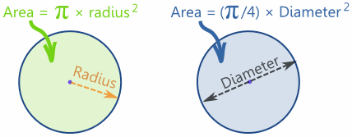
Measuring Tree Size
Cross Sectional Area of a Circle

Slide 47
Unit Cost
Cost per unit Trunk Area of nursery stock ($/in²)
Largest Commonly Available Nursery Tree (LCANT)
Derived from actual nursery data

Slide 48
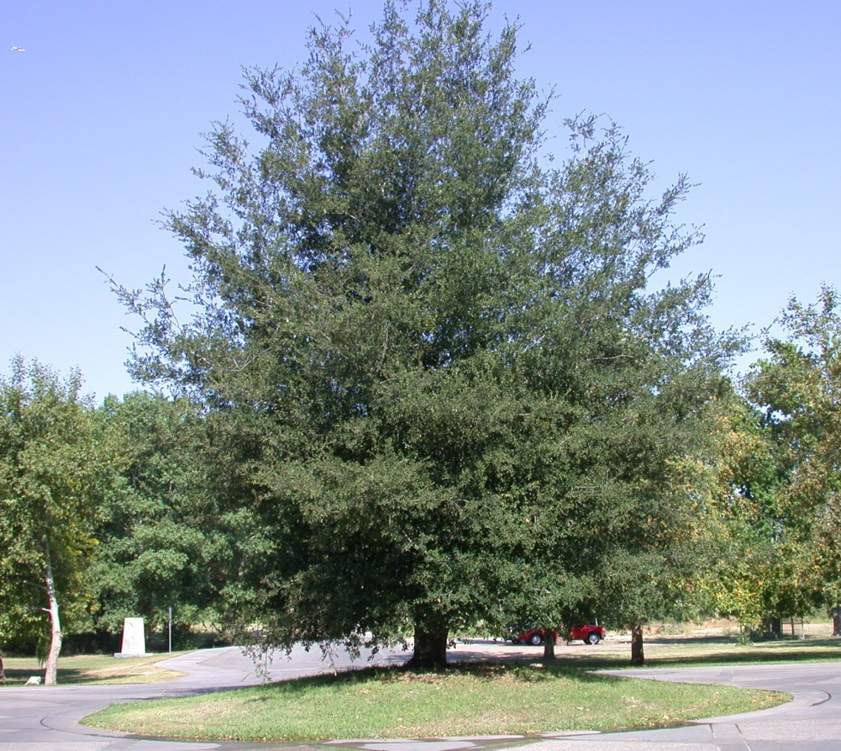
Basic Cost
“Notionally Ideal Tree”
Simplified Calculation
Trunk Area x Unit Cost
Installation cost added later
No Adjusted Trunk Area (ATA)

Slide 49
Depreciation Factors
Reduce Basic Cost to account for loss of value
Condition Rating
Functional Limitations Rating
External Limitations Rating
Value range from 0-100%

Slide 50
Depreciation Factors
Changes for 10th edition
No species rating
No location rating
Species, location, and ATA incorporated into functional and external limitations ratings

Slide 51
Condition
Health
Structure
Form
Excellent 81%-100%
Good 61%-80%
Fair 41%-60%
Poor 21%-40%
Very Poor 6%-20%
Dead 0%-5%

Slide 52
Condition
Combining Health Structure, and Form
Lowest Rating
Mean Value
Weighted Average
Intuitive

Slide 53
Functional Limitations
Interaction of species and site
How effective it is at performing its function

Slide 54
Functional Limitations
Allergenic properties
Light/glare shield
Shade and cooling
Safety barrier
Wind control
Traffic control
Erosion control
Cleanliness of flowers, leaves, and fruit

Slide 55
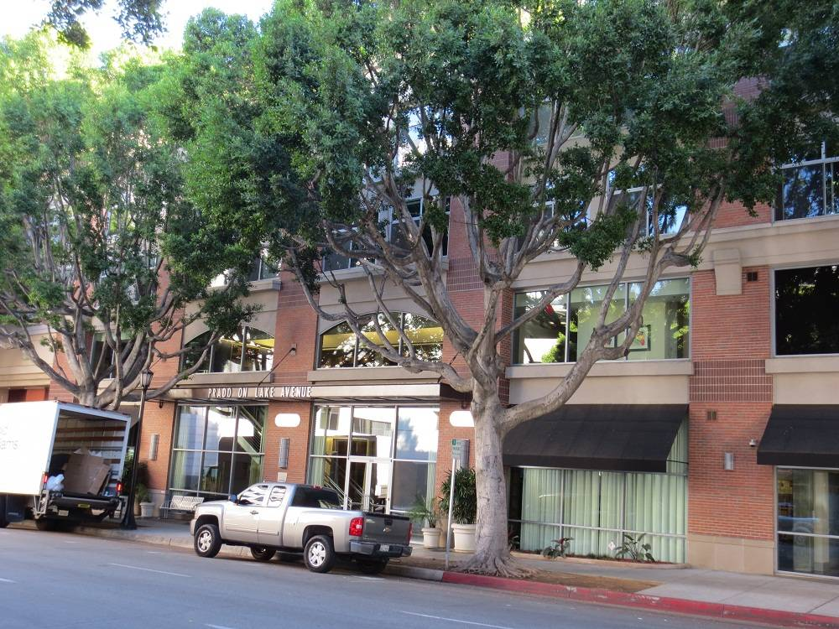
Functional Limitations

Slide 56
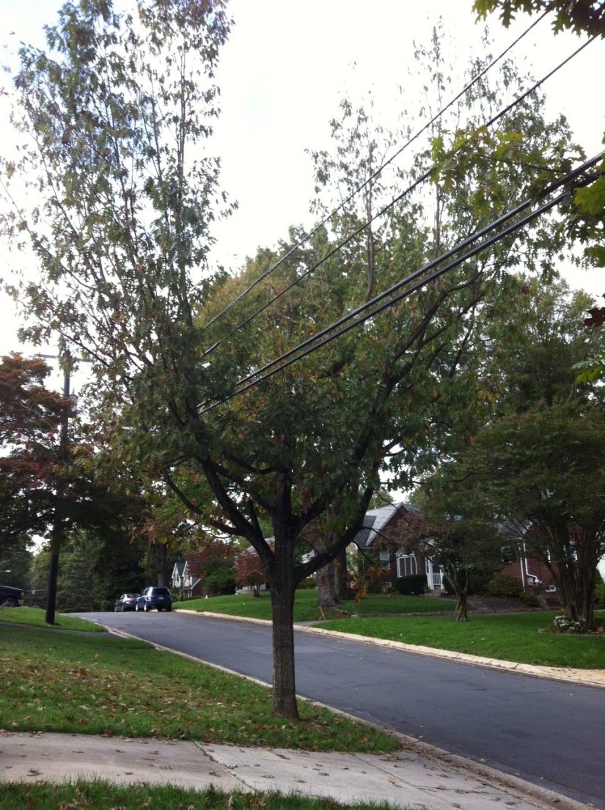
Functional Limitations

Slide 57
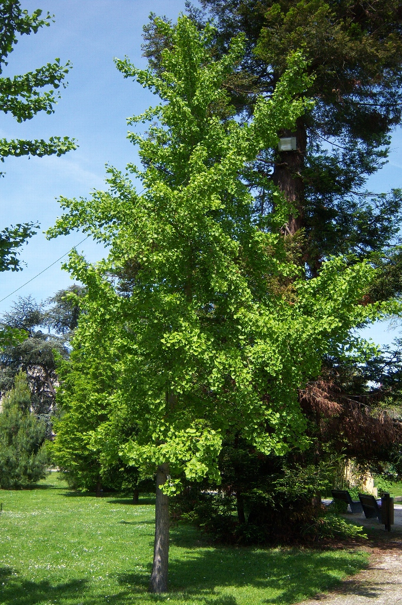
Functional Limitations

Slide 58
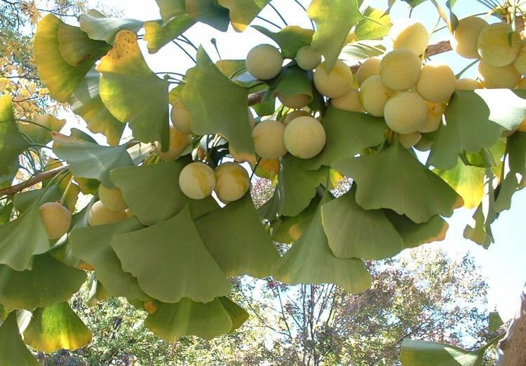
Functional Limitations

Slide 59
External Limitations
Factors outside of the property
Out of control of property owner
Affect plant condition

Slide 60
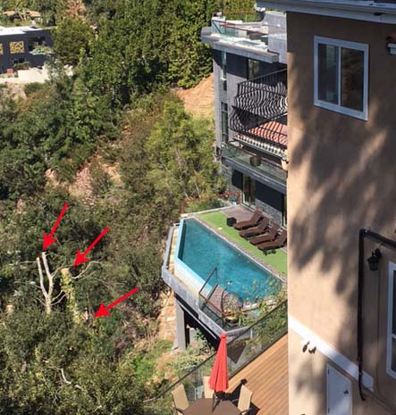
External Limitations
View Ordinances or CCRs

Slide 61
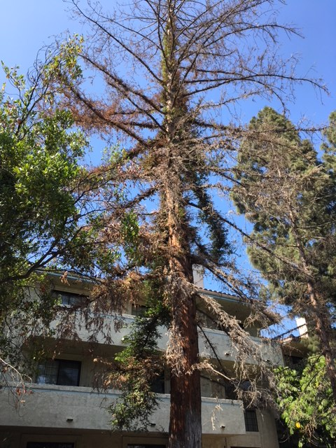
External Limitations
View Ordinances or CCRs
Water use restrictions

Slide 62
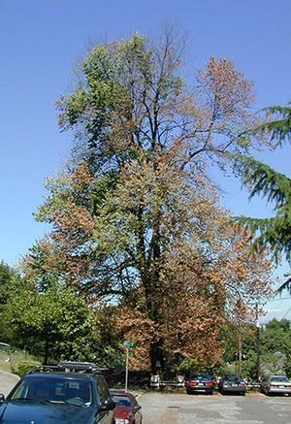
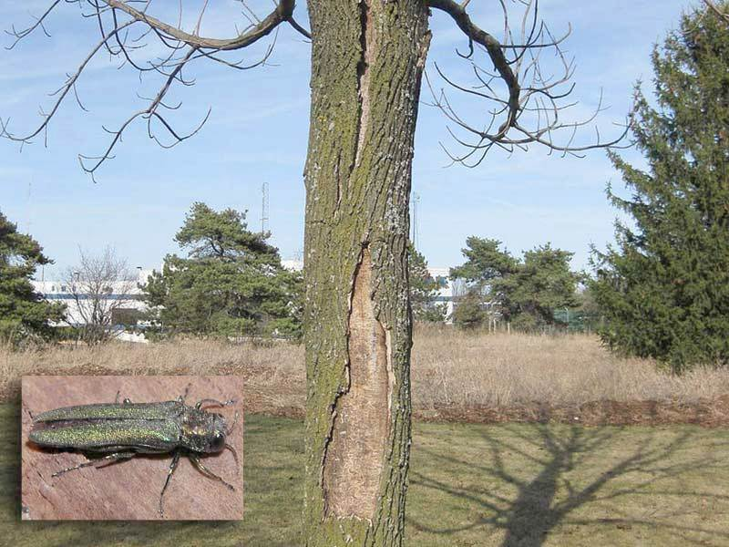
External Limitations
View Ordinances or CCRs
Water use restrictions
Presence of Serious Pests

Slide 63
Final Calculation
Basic Cost x
Condition Rating x
Functional Limitations Rating x
External Limitations Rating
= Depreciated Cost

Slide 64
Final Calculation
Additional Costs
Installation
Stump Removal
Post-Planting Monitoring
Collateral Repairs

Slide 65
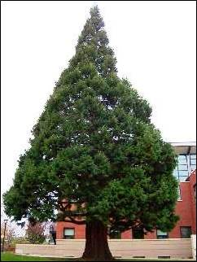
TFT Practice
Redwood growing on college campus in the San Francisco Bay Area, near a library.

Slide 66
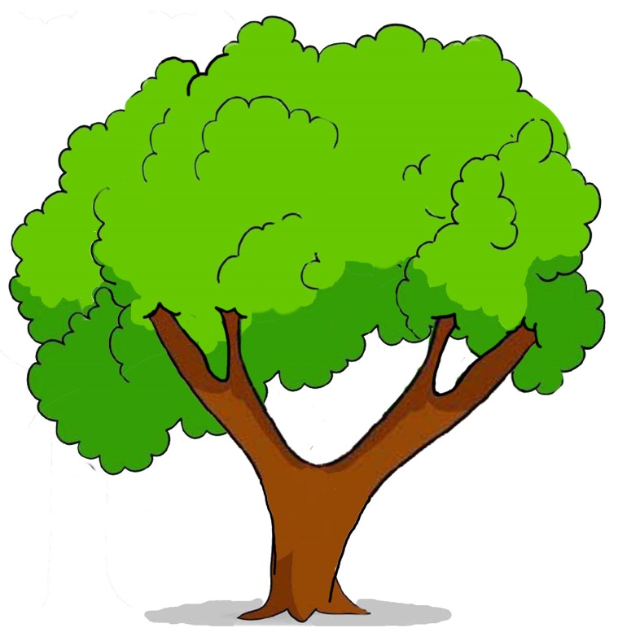
Appraising Partial Losses
Stem tissue loss
Trunk Area adjustment
Canopy loss
% adjustment

Slide 67
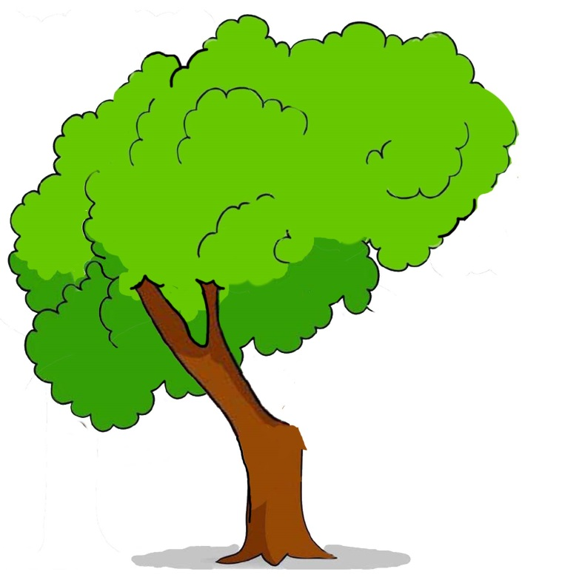
Appraising Partial Losses
TFT cost solution = $12,000 pre-loss
Left Trunk: 12” DBH
Right Trunk: 12” DBH – LOSS
Notes:
Turn to page 7 in workbook

Slide 68
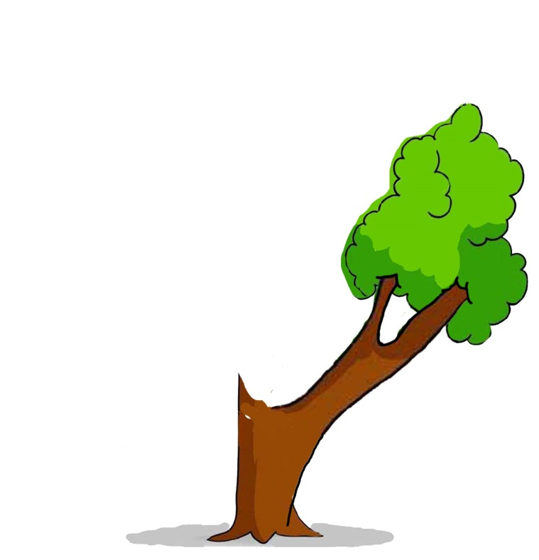
Appraising Partial Losses
TFT cost solution = $12,000 pre-loss
Left Trunk: 12” DBH – LOSS
Right Trunk: 12” DBH

Slide 69
Appraising Trees with Defects
Incurable Defect
Basic Cost x depreciation (including defect)
= Depreciated cost
Curable Defect
Basic Cost x depreciation (without defect)
= Depreciated cost
- Cost of Repair
= Adjusted Depreciated cost

Slide 70
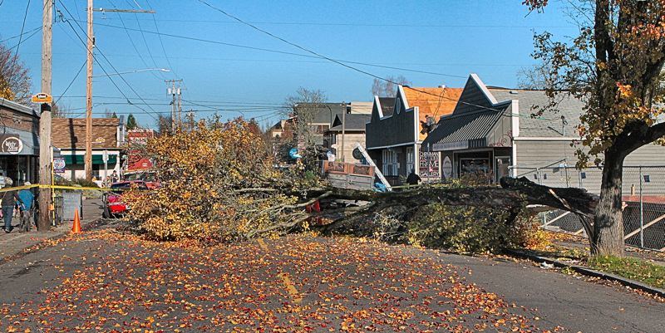
Appraising Trees with Defects
Incurable Defect
Notes:
Page 9 in workbook

Slide 71
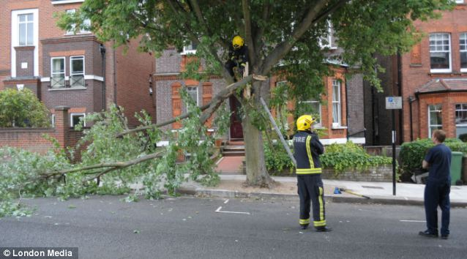
Appraising Trees with Defects
Curable Defect
Notes:
Page 12 workbook

Slide 72
Cost of Repair
Assumptions
Tree will remain in place
Tree will continue to provide benefits
Tree will not be completely restored to pre-loss condition
Estimated Costs to be Incurred
Appraiser
Contractor Quotes
Actual Costs Incurred

Slide 73
Cost of Repair ≠ Tree With Curable Defects
Cost of Repair
How much does it cost to fix the defect?
Cost of Tree With Curable Defects
How much would it cost to reproduce a defect-free tree, less the cost of fixing the defect?

Slide 74
Cost of Repair
Estimates for Cost of Repair

Slide 75
Cost of Repair
Estimates for Cost of Repair:
Company A: $1,000
Company B: $800
Company C: $500

Slide 76
Cost of Repair
Estimates for Cost of Repair:
Company A: $1,000
Company B: $800
Company C: $500
Actual Cost Incurred: $2,200

Slide 77
Cost Forwarding
Interest Rate (r)
Time to Parity (t)
Installed Tree Cost (P)
Compounded Basic Cost (C)
t
C = P(1+r)

Slide 78
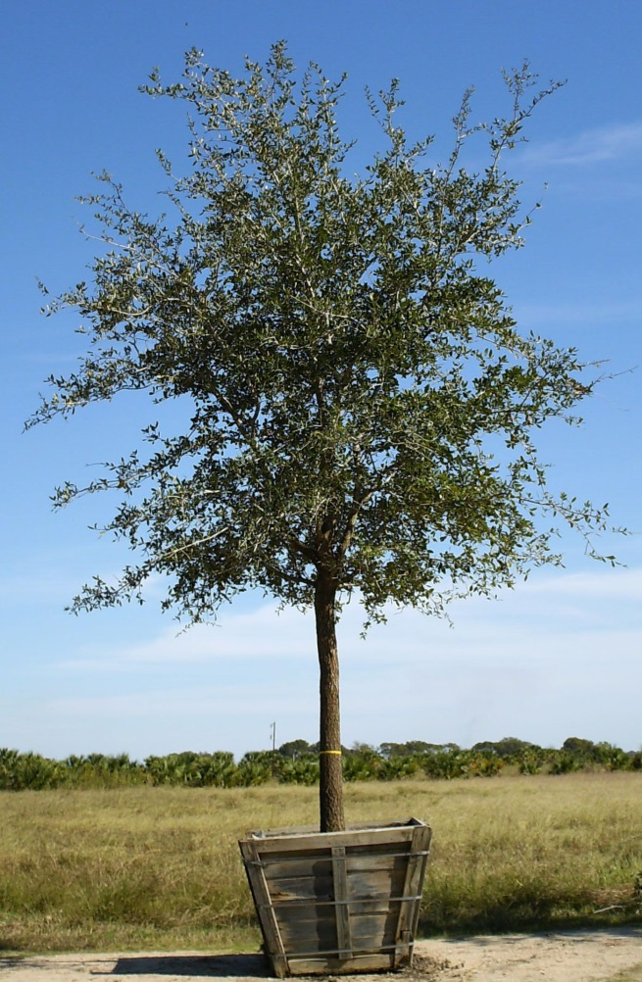
Cost Forwarding
Installed Tree Cost
Wholesale Cost
Shipping
Labor
Overhead
Profit

Slide 79
Cost Forwarding
Interest Rate
Rate of return on a similar investment
Assumes positive rate of return
Common benchmarks
30-yr fixed mortgage rate
10-yr treasury bond

Slide 80
Years to Parity
Number of years to grow replacement tree to subject tree size
Age Metrics
Height of tree
Trunk size (DBH)
Number of annual rings (coring)
Growth Rate
Appraiser experience
Horticultural database

Slide 81
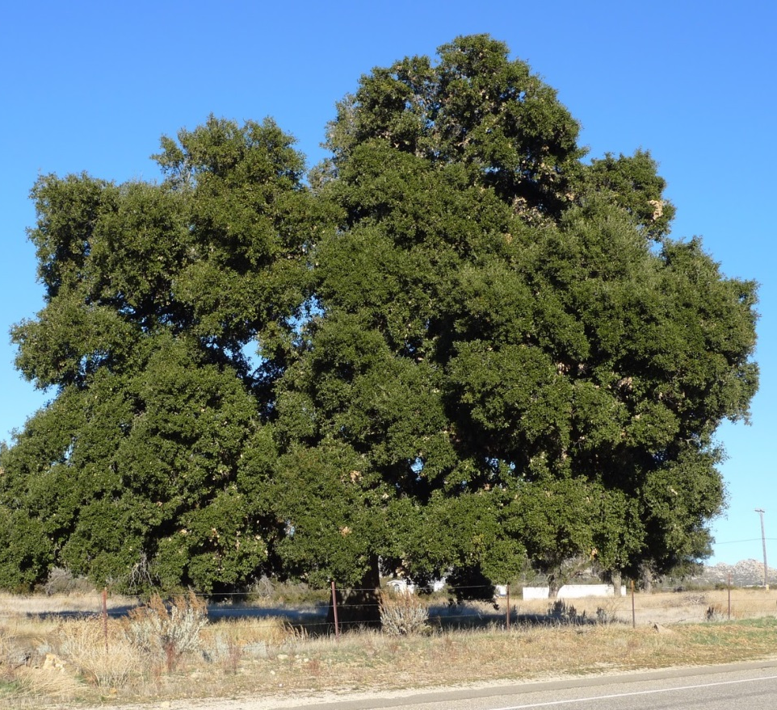
Cost Forwarding
Installed Tree Cost (P): $1482
Interest Rate (r): 3.25%
Years to Parity (t): 100
t
C = P(1+r)

Slide 82
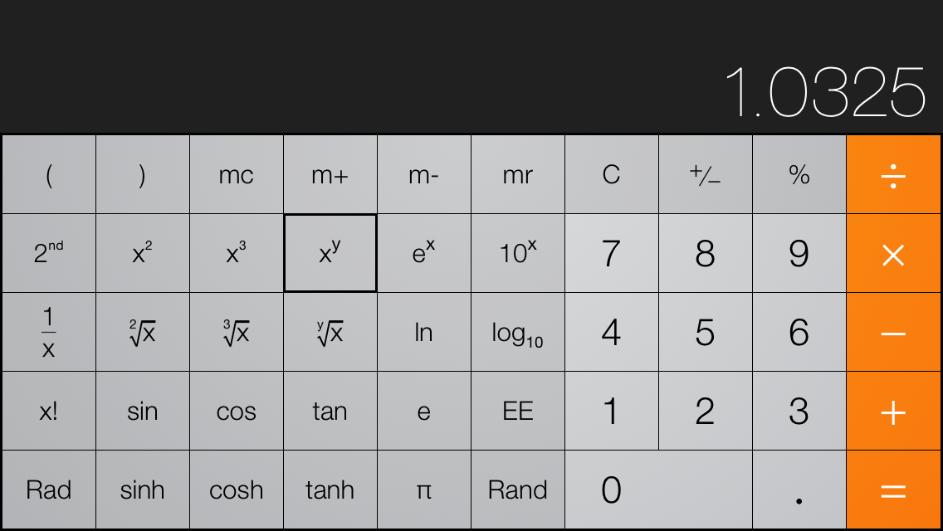
Calculator Steps

Slide 83
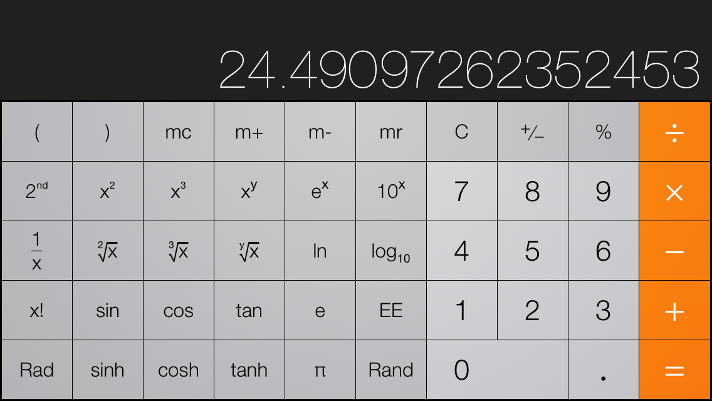
Calculator Steps

Slide 84
Cost Forwarding
Installed Tree Cost (P): $1482
Interest Rate (r): 3.25%
Years to Parity (t): 100
t
C = P(1+r)

Slide 85
Cost Forwarding
Interest Rate (r)
30-yr mortgage: 3.75%
30-yr treasury bond: 2.28%
10-yr treasury bond: 1.70%
Prime plus 2%: 4.50%
Savings Account Yield: 0.10%

Slide 86
Cost Forwarding
Installed Tree Cost (P): $1482
Interest Rate (r): 3.25%
Years to Parity (t)
Height
Tree is 66 feet tall
Grows at 2ft per year
Replacement tree is 6ft tall

Slide 87
Cost Forwarding
Installed Tree Cost (P): $1482
Interest Rate (r): 3.25%
Years to Parity (t)
Annual Rings
120 rings in core sample
10 rings in replacement tree

Slide 88
Approaches to Appraisal
Sales Comparison Approach
Paired Sales
Hedonic Regression Technique
Timber Sales
Income Approach
Present value of income generated by trees
Indirect Income – benefits of trees
Cost Approach

Slide 89
Sales Comparison Approach
“The most probable price that a property should bring in a competitive and open market under all conditions requisite to a fair sale, the buyer and seller, each acting prudently, knowledgeably and assuming the price is not affected by undue stimulus.”

Slide 90
Sales Comparison Approach
“The most probable price that a property should bring in a competitive and open market under all conditions requisite to a fair sale, the buyer and seller, each acting prudently, knowledgeably and assuming the price is not affected by undue stimulus.”

Slide 91
Value Proposition

Slide 92
Value Proposition

Slide 93
Value Proposition

Slide 94
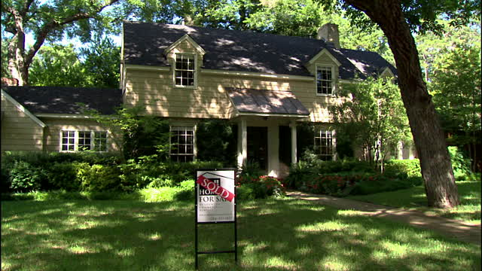
Sales Comparison Approach
Paired Sales Technique
Hedonic Regression Technique
Timber Value

Slide 95
Paired Sales Technique
Difference in value between property with and without tree
Imprecise
Difficult to find comparables
Useful as an Anchor

Slide 96
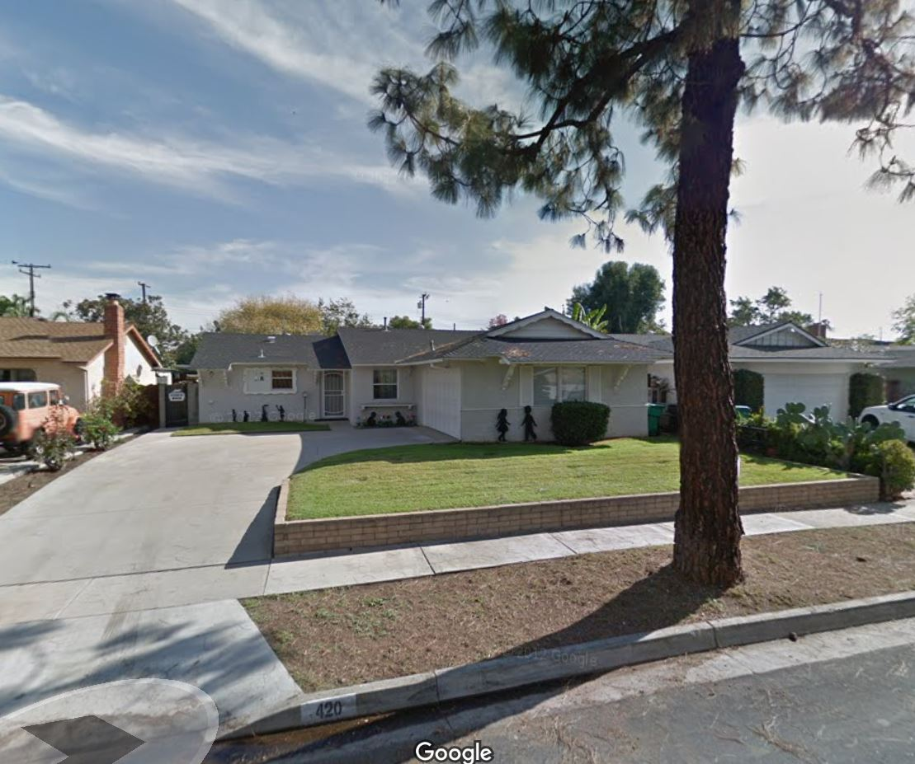
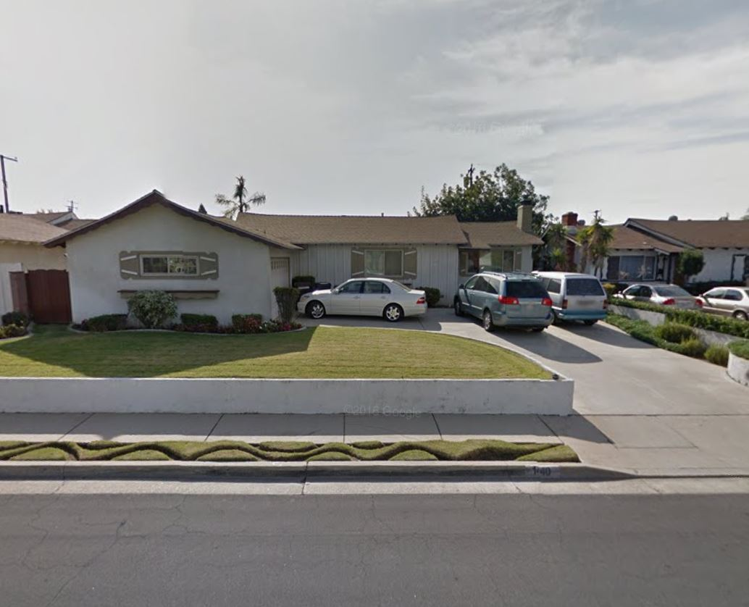
Paired Sales Technique
1022 Renell St
$355,000
1061 Nordoff St
$330,000
Notes:
What can’t we see in this comparable? The interior upgrades

Slide 97
Hedonic Regression Technique
Proxy: Percentage of landscape value
Original Research: History of sales for other real estate parcels with and without attractive landscaping
Existing Research:
Contribution | Citation
6-10% | Henry, Mark. Landscape Quality and the Price of Single Family Houses. Journal of Environmental Horticulture. 1999.
5-12% | Luttik, Joke. The Value of Trees, Water, and Open Space as Reflected by House Prices in the Netherlands. Landscape and Urban Planning. 2000.

Slide 98
Hedonic Regression Technique
Proxy: Percentage of landscape value
Define tree’s contribution to landscape
Canopy cover %
Biomass volume %
Special weighting for key landscape assets

Slide 99
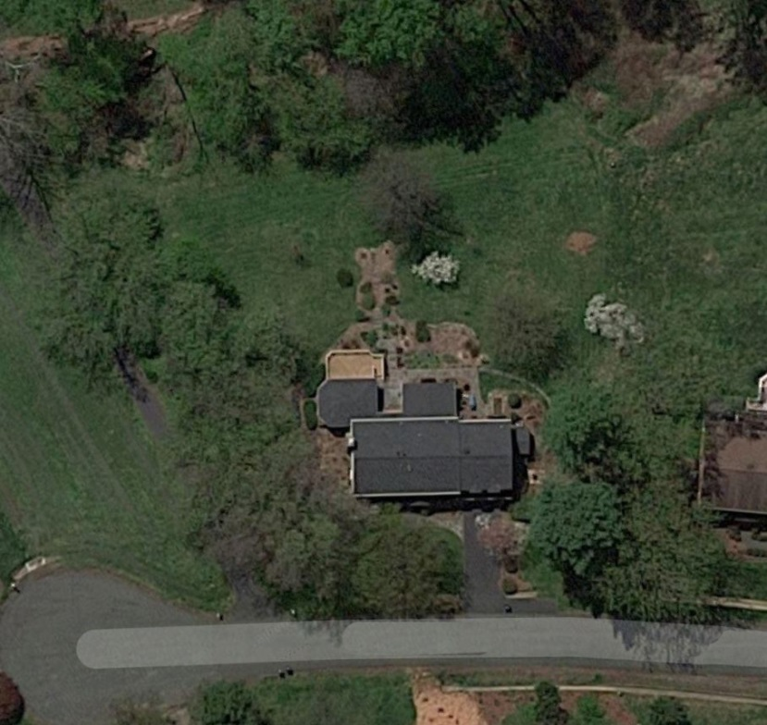
Hedonic Regression Technique
Proxy: Percentage of landscape value
Trees:
Turf:
Garden:
Other:

Slide 100
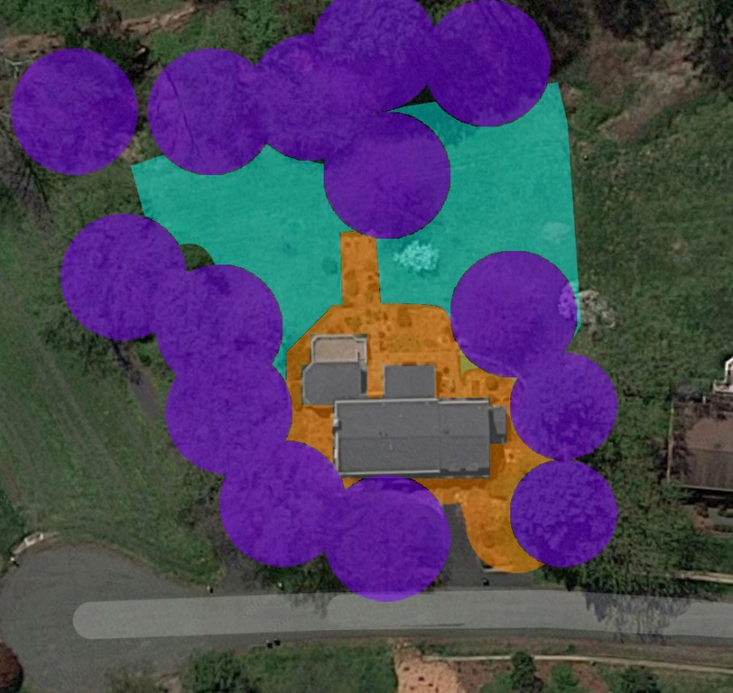
Hedonic Regression Technique
Proxy: Percentage of landscape value
Trees: 30%
Turf: 20%
Garden: 25%
Other: 25%

Slide 101
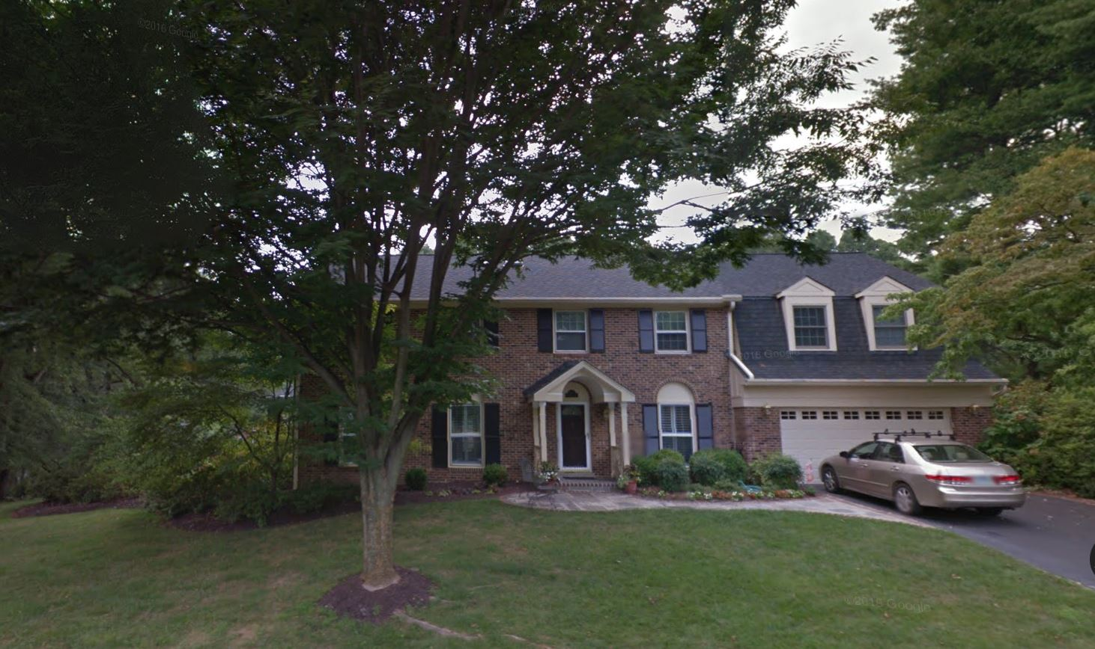
Hedonic Regression Technique
Proxy: Percentage of landscape value
Trees: 60%
Turf: 20%
Garden: 15%
Other: 5%

Slide 102
Hedonic Regression Technique
Proxy: Percentage of landscape value
Value of Real Estate |  | $650,000
Landscape Contribution (6% of Total Value)
Trees | 60%
Turf | 20%
Garden | 15%
Other | 5%
Notes:
Page 16 in workbook

Slide 103
Hedonic Regression Technique
Proxy: Percentage of landscape value
Value of Real Estate |  | $650,000
Landscape Contribution (6% of Total Value) |  | $39,000
Trees | 60%
Turf | 20%
Garden | 15%
Other | 5%

Slide 104
Hedonic Regression Technique
Proxy: Percentage of landscape value
Value of Real Estate |  | $650,000
Landscape Contribution (6% of Total Value) |  | $39,000
Trees | 60% | $23,400
Turf | 20% | $7,800
Garden | 15% | $5,850
Other | 5% | $1,950

Slide 105
Hedonic Regression Technique
Proxy: Percentage of landscape value
How much is each tree worth?
How much does a single tree contribute to “trees”?

Slide 106
Timber Value
Lumber in board-feet minus processing costs
Sources of data
Mills for processing costs
Published market data for timber value
Tree measurements
GlobAllomeTree

Slide 107
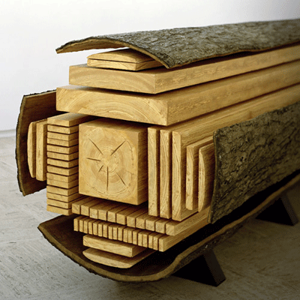
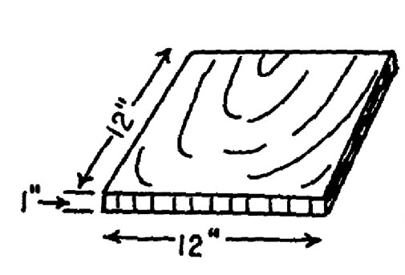
Timber Value
Merchantable Volume
Board Feet
Gross Volume
Net Volume (no defects)

Slide 108
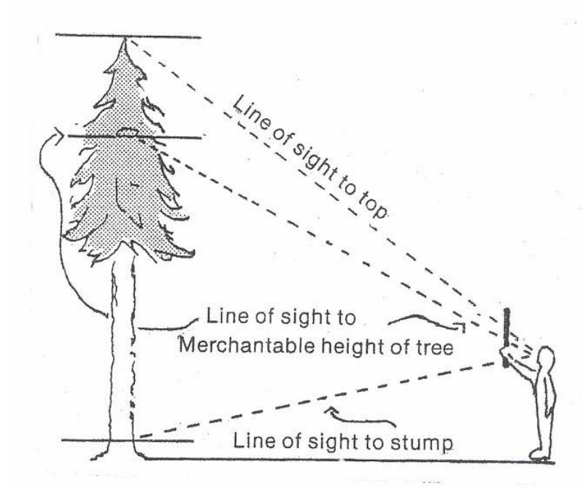
Timber Value

Slide 109
Timber Value
Merchantable Volume
Table 1. Standing Tree Board Foot Volumes—Doyle Rule
Dbh (inches) | Number of 16-Foot Logs
 | 1/2 | 1 | 1-1/2 | 2 | 2-1/2 | 3 | 3-1/2 | 4
Board Feet
12 | 20 | 30 | 40 | 50 | 60
14 | 30 | 50 | 70 | 80 | 90 | 100
16 | 40 | 70 | 100 | 120 | 40 | 160 | 180 | 190
18 | 60 | 100 | 130 | 160 | 200 | 220 | 40 | 160
20 | 80 | 130 | 180 | 220 | 260 | 300 | 320 | 360
22 | 100 | 170 | 230 | 280 | 340 | 380 | 420 | 460
24 | 130 | 220 | 290 | 360 | 430 | 490 | 540 | 600
26 | 160 | 260 | 360 | 440 | 520 | 590 | 660 | 740
28 | 190 | 320 | 430 | 520 | 620 | 710 | 800 | 880
30 | 230 | 380 | 510 | 630 | 740 | 840 | 940 | 1,040
32 | 270 | 440 | 590 | 730 | 860 | 990 | 1,120 | 1,220
34 | 300 | 510 | 680 | 850 | 1,000 | 1,140 | 1,300 | 1,440
36 | 350 | 580 | 780 | 970 | 1,140 | 1,310 | 1,480 | 1,640
38 | 390 | 660 | 880 | 1,100 | 1,290 | 1,480 | 1,680 | 1,860
40 | 430 | 740 | 990 | 1,230 | 1,450 | 1,660 | 1,880 | 2,080
42 | 470 | 830 | 1,100 | 1,370 | 1,620 | 1,860 | 2,100 | 2,320

Slide 110
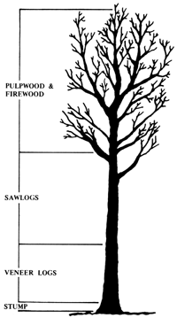
Timber Value
$4.64/board-foot
16-foot logs
1.0 x 22” diameter
1.0 x 16” diameter
0.5 x 12” diameter

Slide 111
Timber Value
$4.64/board-foot
16-foot logs
1.0 x 22” diameter
1.0 x 16” diameter
0.5 x 12” diameter
170+70+20 = 260 board feet
$1206.04

Slide 112
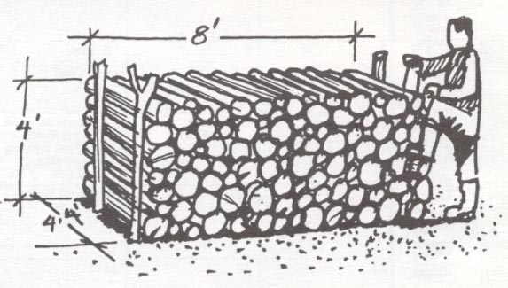
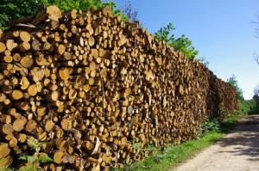
Firewood and Pulpwood Value
Measurements
Cord
Ton
Sources of data
Wholesalers
Timber Market News
Tree measurements

Slide 113
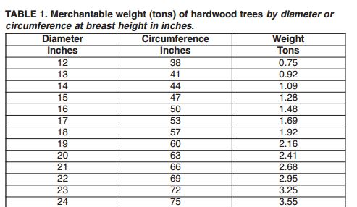
Pulpwood Value
Estimated Weight

Slide 114
Pulpwood Value
Pulpwood Market Price: $35/ton
2.41 tons estimated
2.41 tons
X $35 / ton
$ pulpwood value

Slide 115
Pulpwood Value
Pulpwood Market Price: $35/ton
2.41 tons estimated
2.41 tons
X $35 / ton
$84 pulpwood value

Slide 116
Approaches to Appraisal
Sales Comparison Approach
Paired Sales
Hedonic Regression Technique
Timber Sales
Income Approach
Present value of income generated by trees
Indirect Income – benefits of trees
Cost Approach

Slide 117
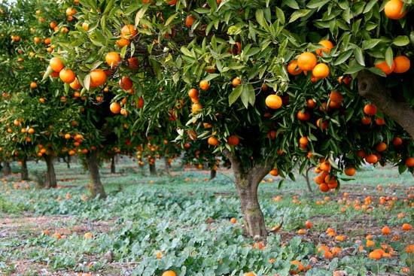
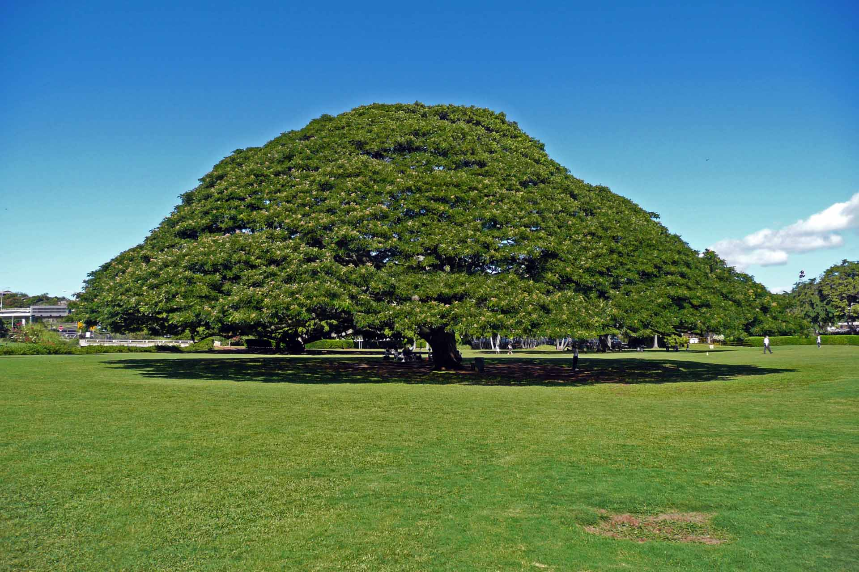
Direct Income Capitalization
Agricultural sales
Fruit production rate
Wholesale price of fruit
Rental Income

Slide 118
Direct Income Capitalization
Annual Income
Interest Rate = Present Value of Income
Assumes tree will provide a constant level of benefits forever
Very sensitive to choice of interest rate

Slide 119
Direct Income Capitalization
Orange Tree
Produces 1,000 oranges / yr
Wholesale price: $0.10/orange
Interest Rate: 10%
Present Value of Benefits?

Slide 120
Direct Income Capitalization
Orange Tree
Produces 1,000 oranges / yr
Wholesale price: $0.10/orange
Interest Rate: 10%
1,000 x $0.10 = $100 / yr
$100 / yr 10% = $1000 present value

Slide 121
Direct Income Capitalization
Hitachi Monkey Pod Tree
Hitachi pays Moanalua Gardens $400,000 per year
Interest Rate: 10%
Present Value of Income Stream?

Slide 122
Direct Income Capitalization
Hitachi Monkey Pod Tree
Hitachi pays Moanalua Gardens $400,000 per year
Interest Rate: 10%
$400,000 / yr 10% = $4M value

Slide 123
Direct Income Capitalization
Hitachi Monkey Pod Tree
Hitachi pays Moanalua Gardens $400,000 per year
Interest Rate: 9%
Reduced Interest Rate?

Slide 124
Direct Income Capitalization
Hitachi Monkey Pod Tree
Hitachi pays Moanalua Gardens $400,000 per year
Interest Rate: 9%
$400,000 / yr 9% = $4,444,444

Slide 125
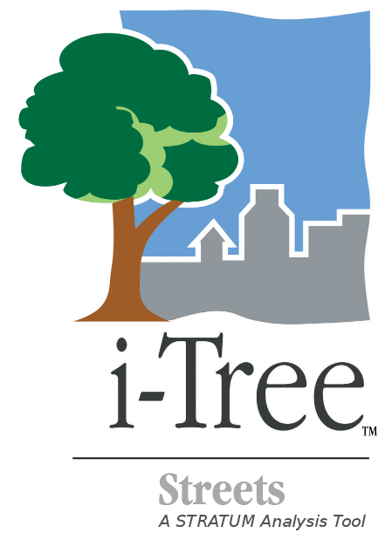
Indirect Income
Benefits Provided
Energy Savings
Stormwater Retention
CO2 Sequestration
Property Value Increase
Limitations
Not all benefits are readily quantifiable
Not all benefits are realized annually
Not precise

Slide 126
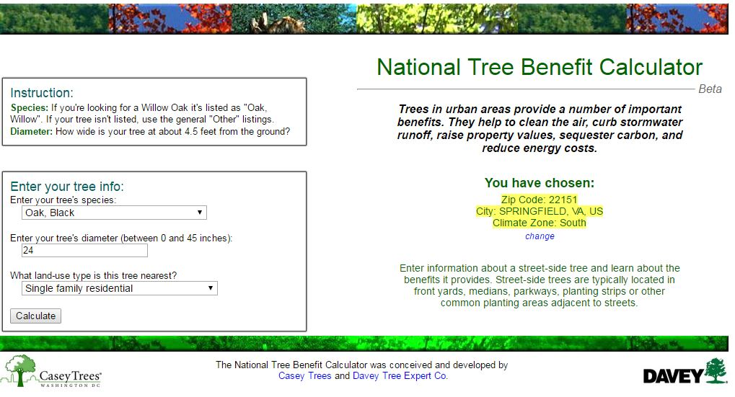
Indirect Income

Slide 127
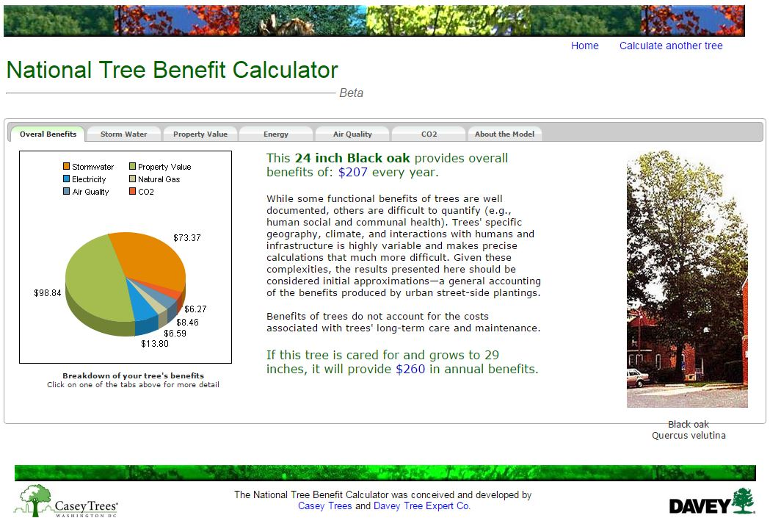
Indirect Income

Slide 128
Indirect Income
Interest Rate: 5%
Present Value of Annual Benefits?

Slide 129
Indirect Income
Benefit | Annual Benefit | Interest Rate | Present Value
Property Value | $98.84 | 5%
Stormwater | $73.37 | 5%
Electricity | $13.80 | 5%
Air Quality | $8.46 | 5%
Natural Gas | $6.59 | 5%
CO2 | $6.27 | 5%
TOTAL | $207.00 | 5%

Slide 130
Indirect Income
Benefit | Annual Benefit | Interest Rate | Present Value
Property Value | $98.84 | 5% | $1,976.80
Stormwater | $73.37 | 5% | $1,467.40
Electricity | $13.80 | 5% | $276.00
Air Quality | $8.46 | 5% | $169.20
Natural Gas | $6.59 | 5% | $131.80
CO2 | $6.27 | 5% | $125.40
TOTAL | $207.00 | 5% | $4,146.60

Slide 131
Reconciliation
Choose and defend selection of methods using anchor values
Aggregate appraisal method outputs
Evaluate the appraisal assignment
Conclude and defend an assignment result

Slide 132
Reconciliation
Method | Output
Reproduction Direct Cost Technique | $1,500,000
Reproduction Trunk Formula Technique | $20,347
Cost Forwarding | $25,252
Direct Income Capitalization | $0
Indirect Income Capitalization | $4,740
Timber Value | $1,206
Paired Sales Technique | $8,000
Sales Comparison Hedonic Regression Technique | $15,000

Slide 133
Reconciliation
Method | Output
Reproduction DCT, median of 3 contractor bids | $1,500,000
Trunk Formula Technique, no depreciation | $45,636
Trunk Formula Technique, with depreciation | $20,347
Cost Forwarding, 8% interest rate, $500 installation cost | $1,099,880
Cost Forwarding, 4% interest rate, $500 installation cost | $25,252
Cost Forwarding, 2% interest rate, $500 installation cost | $3,622
Paired Sales Technique | $15,000
Hedonic Regression Technique | $2,300

Slide 134
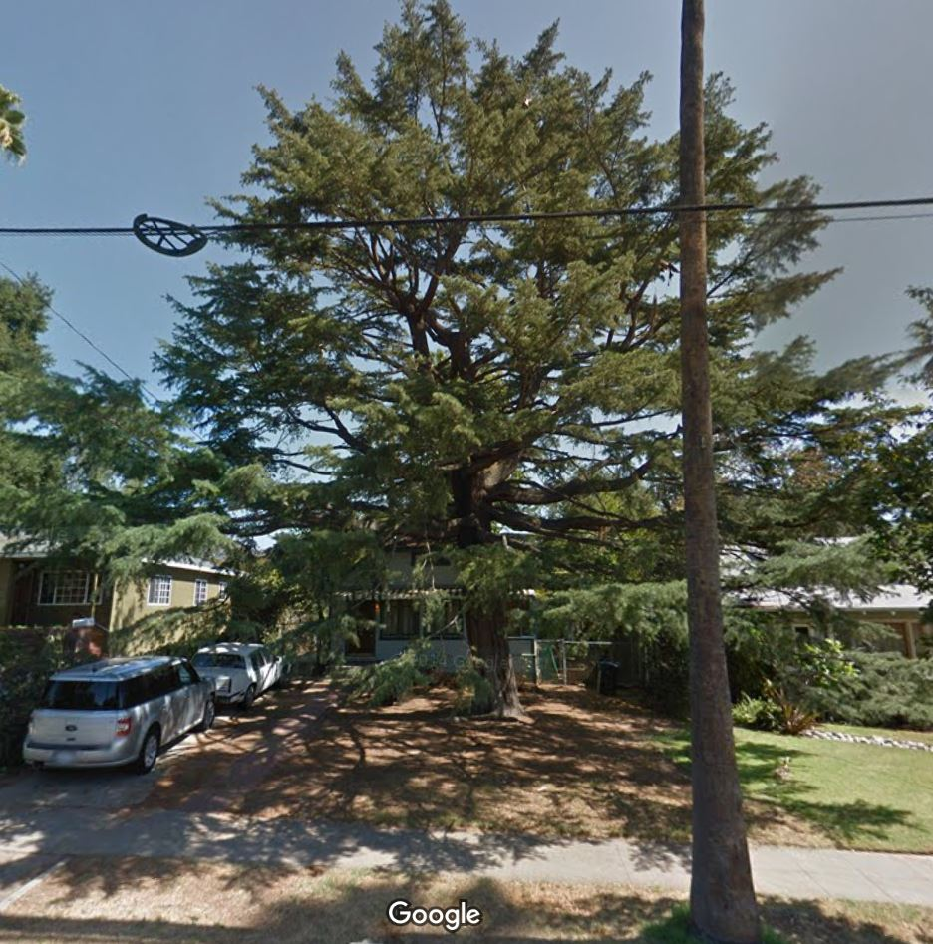
Reconciliation

Slide 135
Reconciliation
What is the ASSIGNMENT?

Slide 136
Reconciliation
Cedars are protected trees by municipal ordinance. Tree owner cuts down the tree. Municipality issues fines based on the “appraised value” of the tree. What is the appraised value?

Slide 137
Reconciliation
Method | Output
Reproduction Direct Cost Technique | $500,000
Reproduction Trunk Formula Technique | $20,347
Cost Forwarding | $25,252
Direct Income Capitalization | $0
Indirect Income Capitalization | $4,740
Timber Value | $1,206
Paired Sales Technique | $15,000
Hedonic Regression Technique | $2,300

Slide 138
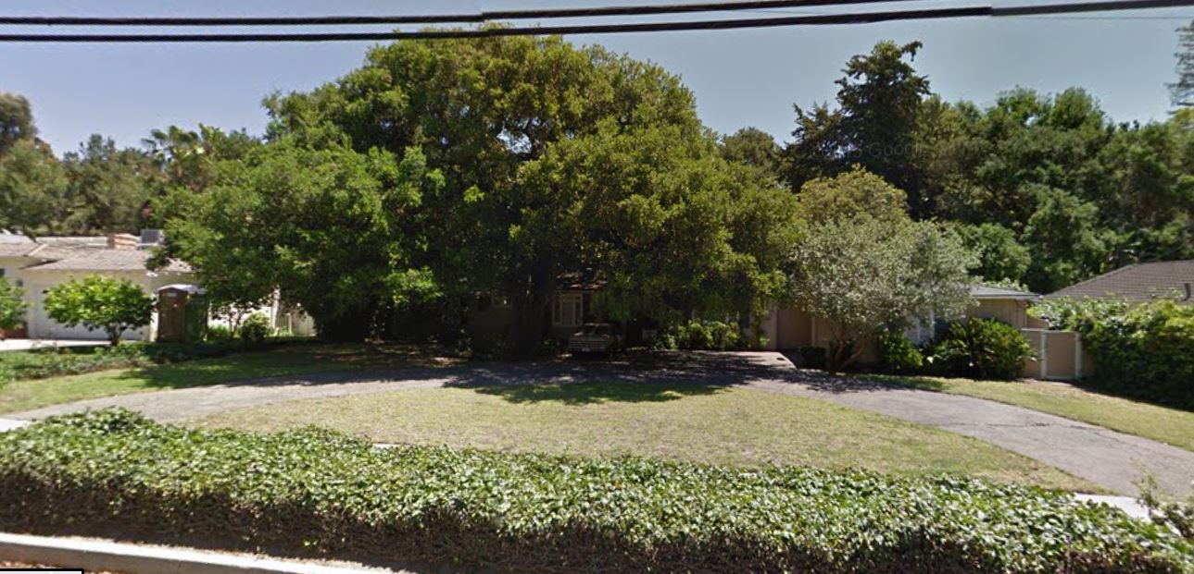
Reconciliation
Real estate investor wants to decide whether the property is worth more with the historic oak or with an additional bedroom. What is the value of the tree?

Slide 139
Reconciliation
Method | Output
Reproduction Direct Cost Technique | $2,500,000
Reproduction Trunk Formula Technique | $97,666
Cost Forwarding, 4% interest rate, $500 installation cost | $179,461
Indirect Income Capitalization | $8,650
Paired Sales Technique | $45,000
Hedonic Regression Technique | $14,400
-------------------------------------------------------------------------- | -----------------
Cost of Construction of the Addition | $40,000
Appraised Value Added by Proposed Addition | $100,000

Slide 140
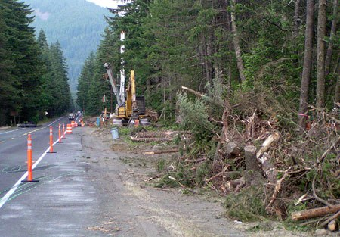
Reconciliation
County enlarges a right-of-way and takes 40 feet of an adjacent vacant forested parcel through eminent domain. Parcel was intended for single family residence development. How much should the landowner ask to be compensated for the trees?

Slide 141
Reconciliation
Method | Output
Reproduction Direct Cost Technique | $8,000,000
Reproduction Trunk Formula Technique | $120,127
Cost Forwarding | $40,542
Timber Value | $8,654
Pulpwood Value | $456
Paired Sales Technique as % of canopy cover | $8,000

Slide 142
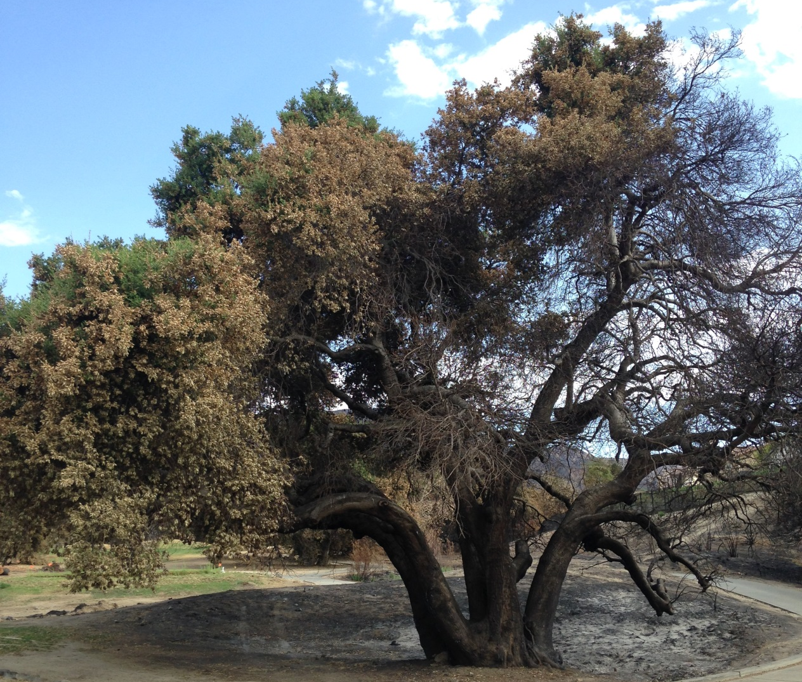
Case Study (1)
Golf Course Fire – Insurance Claim

Slide 143
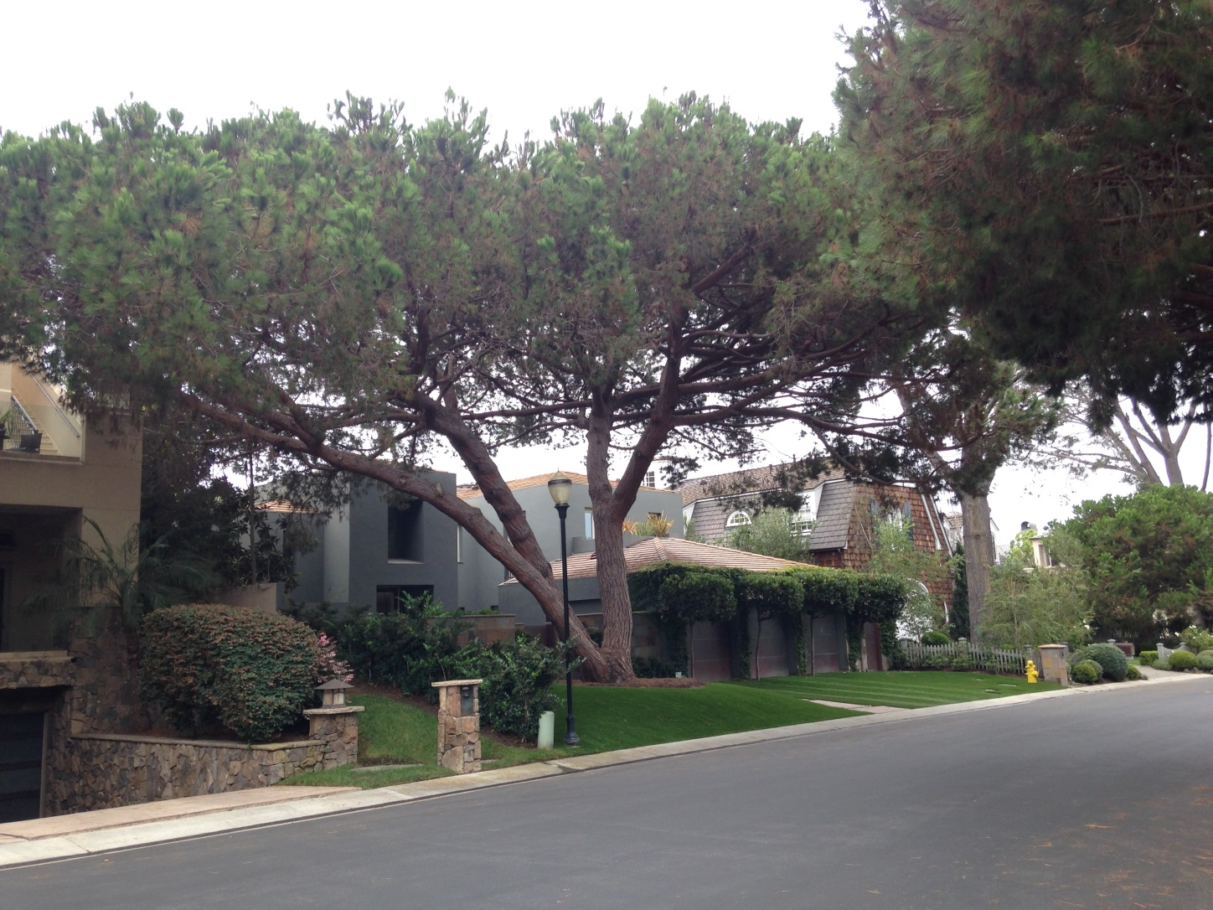
Case Study (2)
Homeowner may damage protected common-area tree roots

Slide 144
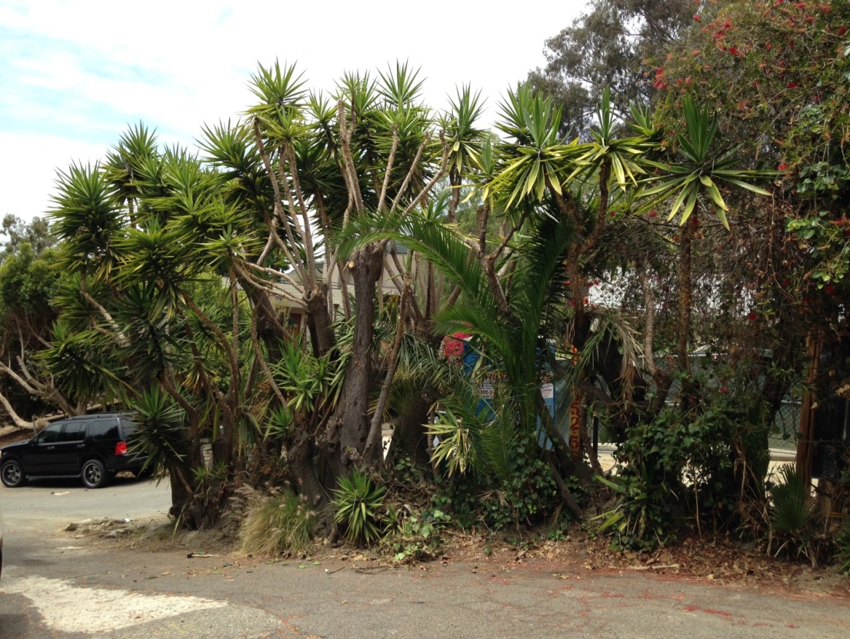
Case Study (3)
Neighbor’s construction damages trees

Slide 145
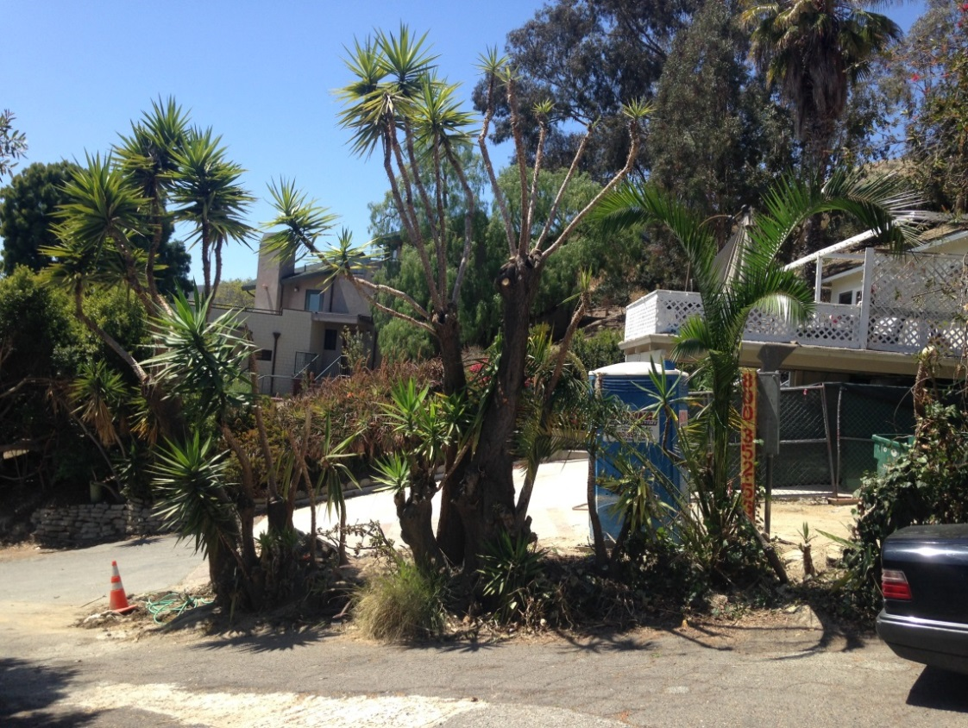
Case Study (3)
Neighbor’s construction damages trees

Slide 146
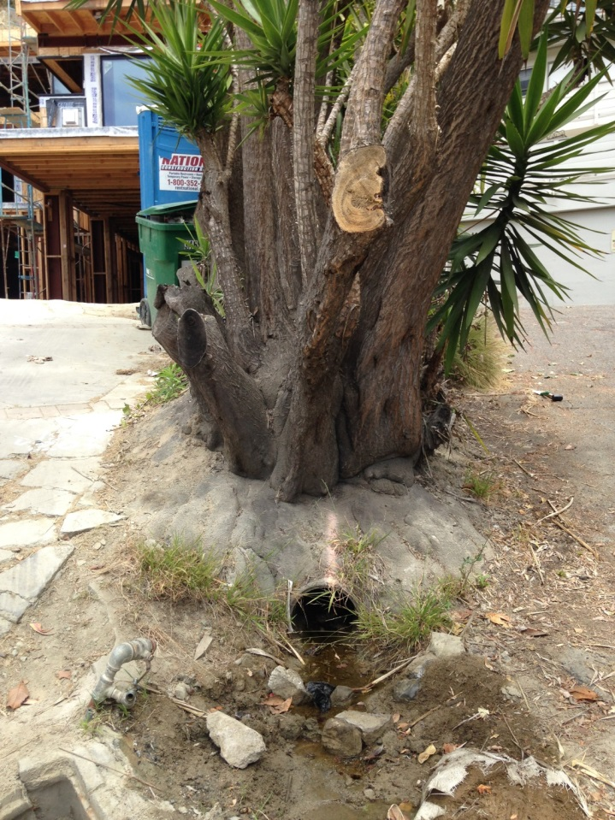
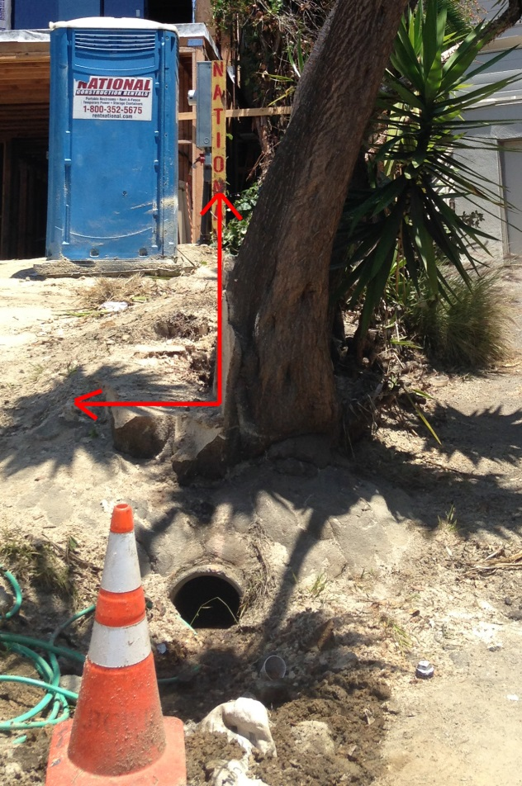
Case Study (3)
Neighbor’s construction damages trees

Slide 147
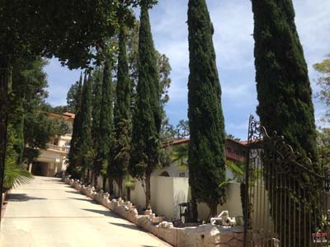
Case Study (4)
Film Shoot Location Tree Damage

Slide 148
Case Study (4)
Film Shoot Location Tree Damage

Slide 149
Case Study (4)
Film Shoot Location Tree Damage
Evidence of film shoots using the trees:

Slide 150
Case Study (4)
Film Shoot Location Tree Damage
Evidence that production companies have declined to use the site and how much income has been generated by film shoots:

Slide 151
Final Thoughts
Appraise with ethics
Define your assignment
Use multiple methods
Reject Outliers
Choose a defensible conclusion

Slide 152
Conclusion
What did we learn?

Slide 153
Anchoring Tree Appraisal
A Multi-Method Approach
Terrence P. Flanagan
BCMA #PN-0120BMTL
James Komen
BCMA #WE-9909B
RCA #555
March 8, 2019

